Slide 1
Introduction to Information Systems and Programming (ISTD 50.001)
Exception Handling

Slide 2
Exceptions
What are exceptions?
Why they are useful?
Different types of exceptions
Handling of exceptions
Throwing exceptions
Catching multiple exceptions
User defined exceptions
Exceptions from nested call hierarchies

Slide 3
What are exceptions?
Exceptions are problems that arise during the execution of a program.
They cause the normal flow of the program to be disrupted and the program to terminate abnormally.
This is most undesirable and therefore, exceptions are to be handled.

Slide 4
Examples of exception
A user has entered an invalid data for example an integer is expected and a String is entered.
A file that needs to be opened cannot be found.
A network connection has been lost in the middle of communications or the JVM has run out of memory.
Some exceptions are out of the programmer’s control, others are because of programmer error, and others are caused by physical resources that have failed in some manner.

Slide 5
Two categories of exceptions
Checked exceptions − A checked exception is an exception that occurs at the compile time, these are also called as compile time exceptions. These exceptions cannot simply be ignored at the time of compilation, the programmer should take care of (handle) these exceptions.
For example, if you use FileReader class in your program to read data from a file, if the FileNotFoundException has not been handled, the compiler prompts the programmer to handle the exception.

Slide 6
Example of checked exceptions
import java.io.File; import java.io.FileReader;
public class DemoExceptions { public static void main (String[] args) { System.out.println("In DemoExceptions"); File file = new File("e:\\ubunturef.pdf"); FileReader fr = new FileReader(file); } }

Slide 7
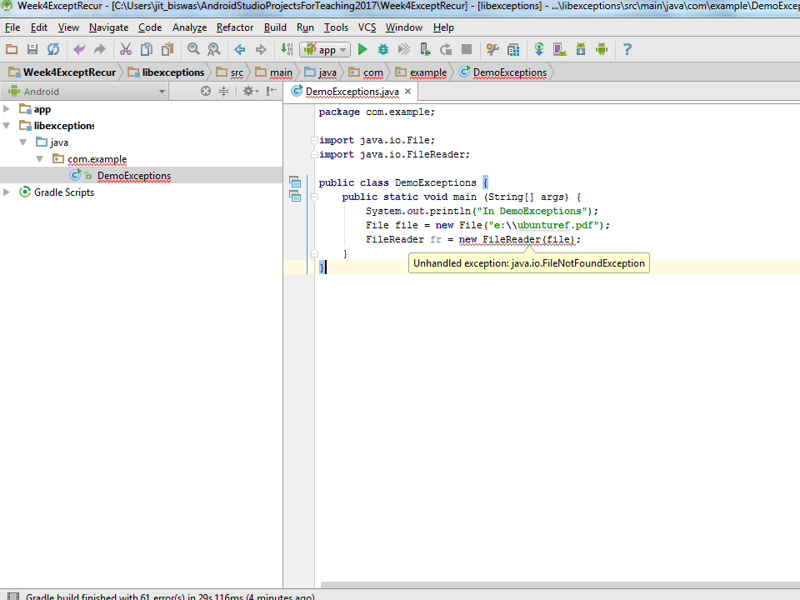
Result: Compile time error

Slide 8
Two categories of exceptions
2. Unchecked exceptions − An unchecked exception is an exception that occurs at the time of execution. These are also called as Runtime Exceptions. These include programming bugs, such as array index out of bounds, or divide by zero. Runtime exceptions are ignored at the time of compilation.
For example, if you declare an array of size 3 in your program, and try to call the 4th element of the array then an ArrayIndexOutOfBoundsExceptionexception occurs.

Slide 9
Example of unchecked exceptions
public class ArrayBounds { public static void main (String[] args) { System.out.println("In Array Bounds demo. "); int[] a = {1,2,3}; System.out.println (a[3]); } }

Slide 10
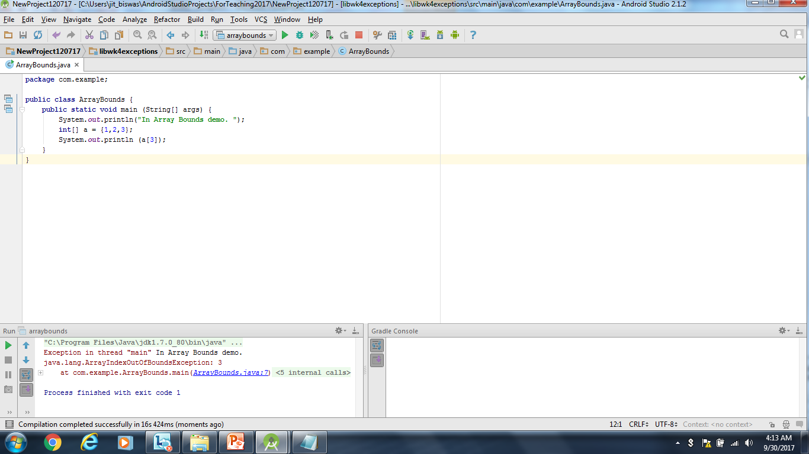
Result: Runtime Error

Slide 11
What Happens When Exceptions Occur
If an exception is thrown then the normal flow of control of a program halts
Instead of executing the regular statements the Java Runtime System starts to search for a matching catch block
The first matching catch block based on data type is executed
When the catch block code is completed the program does not "go back" to where the exception occurred.
It finds the next regular statement after the catch block

Slide 12
How an Exception is Created
As a program runs, if a situation occurs that is handled by exceptions then an Exception is thrown.
An Exception object of the proper type is created
flow of control is transferred from the current block of code to code that can handle or deal with the exception
the normal flow of the program stops and error handling code takes over (if it exists.)

Slide 13
Using try-catch Blocks
If you want to handle the a checked exception locally then use the keywords try and catch
the code that could cause an exception is placed in a block of code preceded by the keyword try
the code that will handle the exception if it occurs is placed in a block of code preceded by the keyword catch

Slide 14
How try and catch work
Code that could cause an exception is placed in a try block
the statements are all included in one try block.
Each try block must have 1 or more associated catch blocks
The catch block is also called the exception handler because it is here that we handle the error.

Slide 15
The finally Block
The finally block follows a try block or a catch block. A finally block of code always executes, irrespective of occurrence of an Exception
Using a finally block allows you to run any cleanup-type statements that you want to execute, no matter what happens in the protected code
A finally block appears at the end of the catch blocks
The finally block is optional, but recommended

Slide 16
Solution - checked exceptions
import java.io.File; import java.io.FileNotFoundException; import java.io.FileReader;
public class DemoExceptions { public static void main (String[] args) { System.out.println("In DemoExceptions"); try { File file = new File("e:\\ubunturef.pdf"); FileReader fr = new FileReader(file); } catch (FileNotFoundException ex) { System.out.println("In exception handler."); System.out.println(ex); } finally { System.out.println("In Finally"); } } }

Slide 17
Solution - checked exceptions
Result (when file exists):
In DemoExceptions
In Finally
Process finished with exit code 0
Result (when file doesn’t exist):
In DemoExceptions
In exception handler.
java.io.FileNotFoundException: e:\ubunturef4444.pdf (The system cannot find the file specified)
In Finally
Process finished with exit code 0

Slide 18
Solution - unchecked exceptions
public class ArrayBounds { public static void main (String[] args) { System.out.println("In Array Bounds demo. "); int[] a = {1,2,3}; try { System.out.println(a[3]); } catch (ArrayIndexOutOfBoundsException ex) { System.out.println("Attempt to access array element " + "that is out of bounds."); System.out.println(ex); } finally { System.out.println("In finally block."); } System.out.println("Continue with normal execution."); }

Slide 19
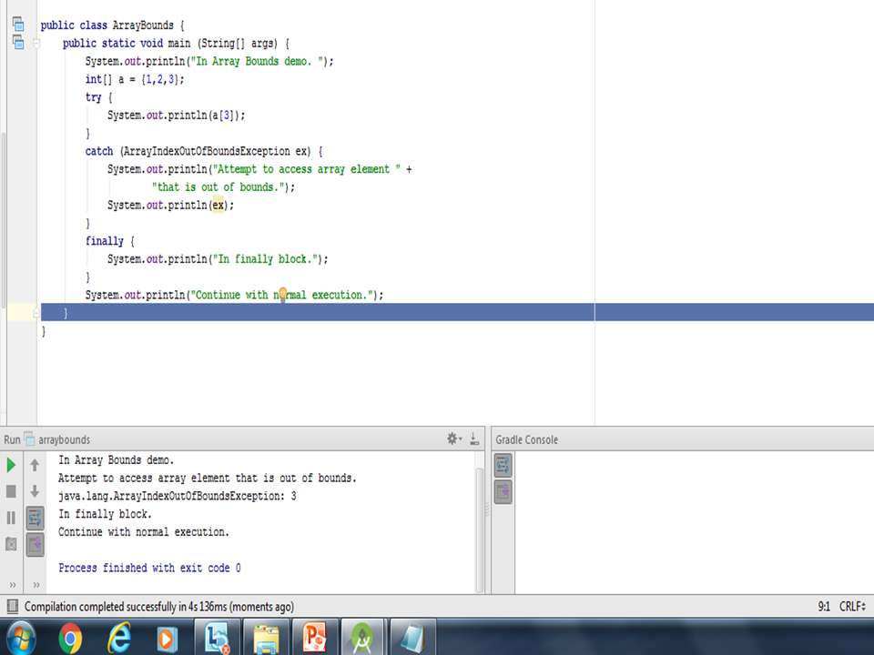

Slide 20
catch – further details
Every try block must have at least one corresponding catch block
the catch blocks have a parameter list of 1
the parameter must be Exception or a descendant of Exception
You may use multiple catch blocks with one try block in case of multiple types of Exceptions

Slide 21
Using throws clause (eg. if you don’t want the exception to be handled in the same class)
public class DemoExceptions { public static void main (String[] args) { System.out.println("In DemoExceptions"); try { checkex(); } catch (FileNotFoundException ex) { System.out.println("In exception handler."); System.out.println(ex); } }
public static void checkEx() throws FileNotFoundException{
File file = new File("e:\\ubunturef.pdf"); FileReader fr = new FileReader(file);
//continue processing here.
}

Slide 22
Methods that throw Exceptions
It may be that we don't know how to deal with an error within the method that can generate it
In this case we will pass the buck to the method that called us
The keyword throws is used to indicate a method has the possibility of generating an exception of the stated type
Now any method calling ours must also throw an exception or handle it

Slide 23
Catching Multiple exceptions
We can have multiple catch blocks for a single try statement. The exception handler looks for a compatible match and then for an exact match. In other words, in the example, if the exception raised was myIOCustomException, a subclass of FileNotFoundException, then the catch block of FileNotFoundExeception is matched and executed.
If a compatible match is found before an exact match, then the compatible match is preferred.
We need to pay special attention on ordering of exceptions in the catch blocks, as it can lead to mismatching of exception and unreachable code.
We need to arrange the exceptions from specific to general.

Slide 24
Catching Multiple exceptions
try {
// Protected code
} catch (ExceptionType1 e1) {
// first catch block
} catch (ExceptionType2 e2) {
// second catch block
} catch (ExceptionType3 e3) {
// third catch block
}

Slide 25
Multiple exceptions
import … public class MultipleExceptions { public static void main(String args[]) { try { File f = new File("e:\\myfile.txt"); FileInputStream fis = new FileInputStream(f); } catch (FileNotFoundException exfnf) { // first catch block } catch (IOException exio) { //do something here }
catch (Exception exception) { //do something here } finally { // the finally block //continue processing here. } } }

Slide 26
Errors
Errors − are not exceptions at all, but problems that arise beyond the control of the user or the programmer. Errors are typically ignored in your code because you can rarely do anything about an error.
For example, if a stack overflow occurs, an error will arise. These cannot be handled by the compiler. Nor can they be handled by the programmer.

Slide 27
Hierarchy
Throwable class is a super class of all exceptions and errors.
Exceptions has a special subclass, the RuntimeException
A user defined exception should be a subclass of the exception class

Slide 28
Exceptions Inheritance (partial)
EOFException
IOException
FileNotFound Exception
Exception
ArrayIndexOut ofBounds Exception
Runtime Exception
Throwable
Error
NullPointer Exception
Arithmetic Exception
Illegal Argument Exception

Slide 29
Summary: checked and unchecked Exception
Exceptions which are checked for during compile time are called checked exceptions.
Exceptions which are not checked for during compile time are called unchecked exception.
All the checked exceptions must be handled in the program.
The exceptions raised, if not handled will be handled by the Java Virtual Machine. The Virtual machine will print the stack trace of the exception indicating the stack of exception and the line where it was caused.

Slide 30
User defined exceptions
You can create your own exceptions in Java.
All exceptions must be a child of Throwable.
If you want to write a checked exception that is automatically enforced by the Handle or Declare Rule, you need to extend the Exception class.
If you want to write a runtime exception, you need to extend the RuntimeException class.

Slide 31
User defined exceptions - example
public class Account {
private double balance;
private int ACnumber;
public Account(int number) {
this.ACnumber = number;
}
public void deposit(double amount) {
balance += amount;
}
public void withdraw(double amount) throws ExceedLimitException {
if(amount <= balance) {
balance -= amount;
} else {
double needs = amount – balance;
throw new
ExceedLimitException(needs);
}
} // … other methods
}
public class ExceedLimitException
extends Exception {
private double amount;
public ExceedLimitException(double
amount) {
this.amount = amount;
}
public double getAmount() {
return amount;
}
}

Slide 32
Question
What is output by the method guessOutput if it is called with the following code?
int[] nums = {3, 2, 6, 1}; guessOutput( nums );
public static void guessOutput(int[] vals){ int total = 0; try{ for(int i = 0; i < vals.length; i++){ int index = vals[i]; total += vals[index]; }
} catch(Exception e){ total = -1; } System.out.println(total); }
A. 1 B. 0 C. 3 D. -1 E. 5

Slide 33
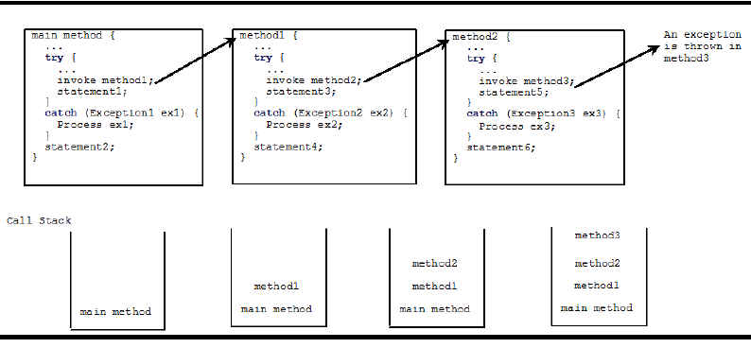
Exceptions across multiple levels

Slide 34
Example – TryExceptions:
Write a method tryexception that calls a method to take the reciprocal of the square root of an integer and returns a double. Prompt the user to enter an integer value. tryexception should throw an InputMismatchException if the input is not an integer. Also catch ArithmeticException within the method if the number is zero, or if the number is negative. Print appropriate messages.

Slide 35
Cohort Exercise 1:
Write a program that checks the scores stored in an array. The method, testScores, will throw IllegalArgumentException ("Element: " + i + " Score: " + s[i]) if the values in array s are less than 0 or bigger than 100. Use try … catch block in main() to handle this exception.

Slide 36
Cohort Exercise 2:
public class CoffeeMaker {
private static final int tooCold = 55;
private static final int tooHot = 85;
public static void makeCoffee(int temperature) throws TooCold, TooHot {
if (temperature <= tooCold) throw new TooCold();
if (temperature >= tooHot) throw new TooHot();
}
}
class TooCold extends Exception{}
class TooHot extends Exception{}

Slide 37
Cohort Exercise2:
Implement an exception handler, within makeCoffee, that will catch the thrown user-defined exceptions (if any) and return a String comment as follows:
Exception String comment
TooCold “Yuck!”
TooHot “Ouch!”
None “Mmm!”

Slide 38
Further Reading
http://docs.oracle.com/javase/tutorial/essential/exceptions/
http://www.tutorialspoint.com/java/java_exceptions.htm

